Slide 1
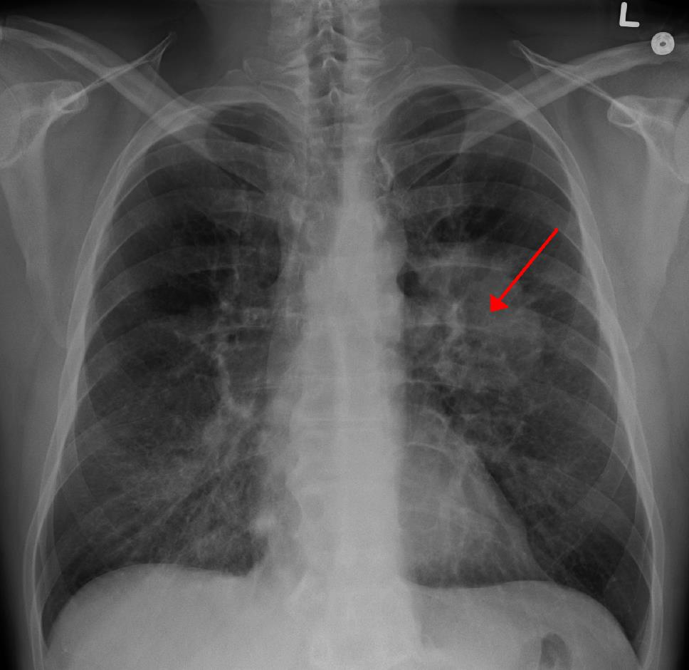
Lung Cancer
Analysis

Slide 2

Impact of Cigarettes
Does Tobacco have an influence on lung cancer?
&
Where is it the most present?

Slide 3
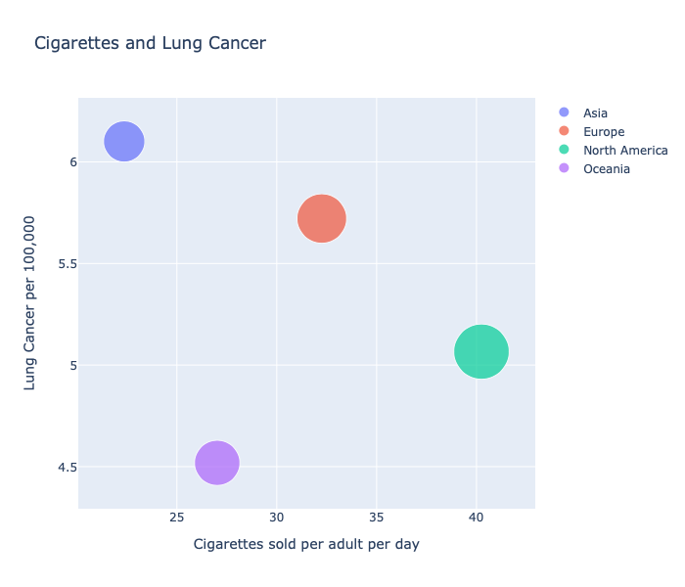
North America is the area of the globe which is the most affected by Lung Cancer.
N America

Slide 4
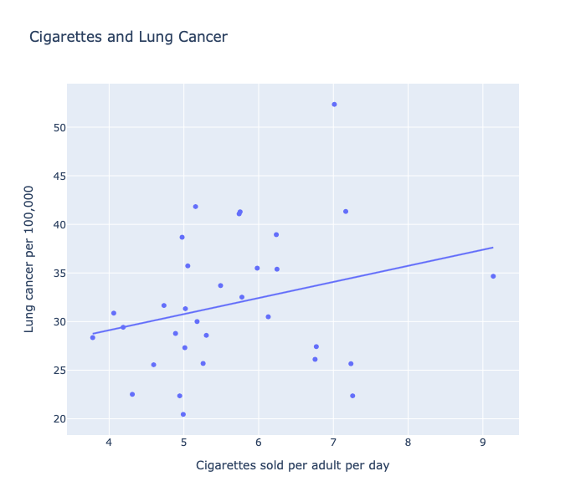
Hungary
There is a positive relationship between Cigarettes sold and lung cancer.
Hungary = worst country in term of lung cancer
Greece = worst country in term of cigarettes sold
Greece

Slide 5
Share of cancer deaths
What are the regions of the world where the share of cancer deaths attributed to tobacco (%) is more significant?

Slide 6
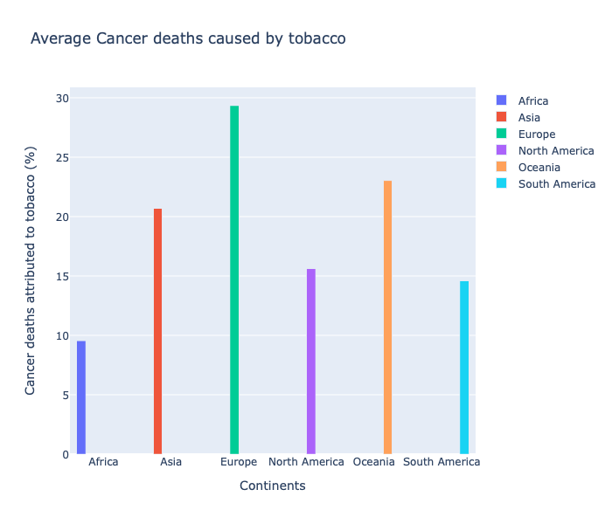
We can observe that Europe has almost 30% of cancer that is caused by tobacco.

Slide 7
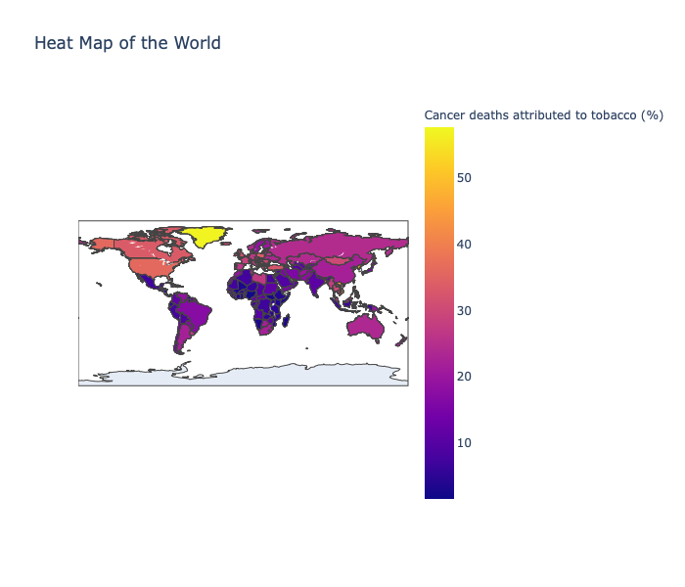
The regions the most affected are the US and Eastern Europe.

Slide 8
Impact of Wealth
Wealth influences the survival rate?

Slide 9
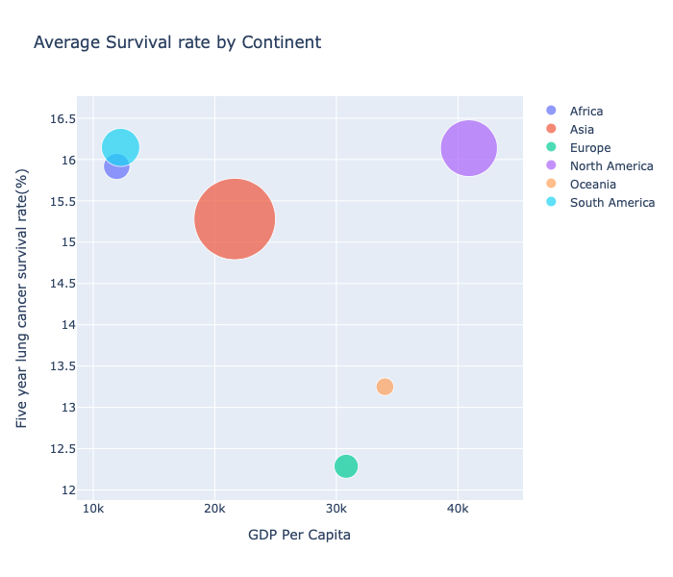
N America
S America
Continents with the highest GDP per Capita does not always have the strongest survival rate.

Slide 10
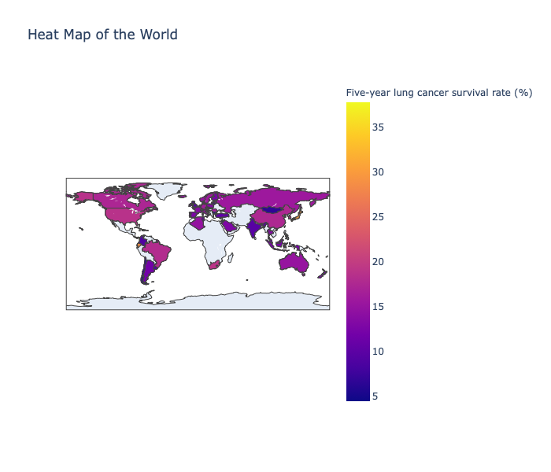
Heat Map representing the distribution of of lung cancer survival rate. Here the US shows the best survival rate.

Slide 11

Thank you for your attention

